Slide 1
DataBase

Slide 2
DataBase Design
Physical

Slide 3

Physical https://www.youtube.com/watch?v=vWz9VN40nCA

Slide 4
Physical DataBases Storage Systems
higher-level models of a database: at the conceptual or logical level, entities, tables, …
these are correct levels for database users to focus on - because the goal of database system is to simplify and facilitate access to data - users of the system should not be burdened unnecessarily with physical details of implementation of system

Slide 5
Physical Storage Media
types of data storage classified by speed with which data can be accessed, by cost per unit of data and by medium’s reliability

Slide 6
Cache
fastest and most costly form of storage
cache memory is relatively small; its use is managed by computer system hardware
database implementors DO pay attention to cache effects when designing query processing

Slide 7
Main Memory
may contain tens of gigabytes of data on personal computer, and are even larger in large server systems
generally, too small (or too expensive) for storing entire database for very large databases, but some enterprise databases can fit in main memory
however, contents of main memory are lost in the event of a power failure or system crash; main memory is said to be volatile

Slide 8
Flash Memory
differs from main memory in that stored data are retained even if power is turned off (or fails) - that is, it is non-volatile
lower cost per byte than main memory
higher cost per byte than (magnetic) disks
widely used for data storage in devices such as cameras and mobles
can be plugged into Universal Serial Bus (USB) slots of computing devices

Slide 9
Solid State Drive (SSD)
flash memory is also increasingly used as a replacement for magnetic disks in personal computers as well as in servers
Solid State Drive (SSD) uses flash memory internally to store data but provides interface similar to magnetic disk, allowing data to be stored or retrieved in units of a block - such interface is called block-oriented interface
block sizes typically range from 512 bytes to 8 kilobytes

Slide 10
Magnetic-disk storage
Hard Disk Drive (HDD)
primary medium for long-term online storage of data is magnetic disk drive
like flash memory is nonvolatile
disks may sometimes fail and destroy data, but such failures are quite rare compared to system crashes or power failures
to access data stored on magnetic disk, system must first move data from disk to main memory, from where they can be accessed
after the system has performed designated operations, data that have been modified must be written to disk

Slide 11
significantly cheaper than SSDs, magnetic HDD disks provide lower performance in terms of number of data access operations that they can support per second

Slide 12
Optical storage
Digital Video Disk (DVD) is an optical storage medium, with data written and read back using a laser light source
Blu-ray DVD format has a larger capacity of 27 to 128 gigabytes
capable of storing any type of digital data, including backups of database contents
are not suitable for storing active database data since the time required to access given piece of data can be quite long compared to magnetic disk

Slide 13
Tape storage
used primarily for backup and archival data
Archival data refers to data that must be stored safely for a long period of time, often for legal reasons
cheaper than disks and can safely store data for many years
access to data is much slower because tape must be accessed sequentially from the beginning of the tape
tape storage is referred to as sequential-access storage and in contrast, magnetic disk and SSD storage are referred to as direct-access storage because it is possible to read data from any location

Slide 14
Storage device hierarchy

Slide 15
fastest storage media, cache and main memory are referred to as primary storage
media in next level in hierarchy, flash memory and magnetic disks are referred to as secondary storage, or online storage
media in lowest level in hierarchy, magnetic tape and optical disk are referred to as tertiary storage, or offline storage

Slide 16
Storage Interfaces
magnetic HDD disks as well as flash-based Solid-State Disks are connected to system through a high-speed interconnection
disks typically support either the Serial ATA (SATA) interface, or the Serial Attached SCSI (SAS) interface; the SAS interface is typically used only in servers
the Non Volatile Memory Express (NVM e) interface is a logical interface standard developed to better support SSDs and is typically used with PCIe interface (the PCIe interface provides high-speed data transfer internal to computer systems)

Slide 17
disks are usually connected directly by cables to disk interface of computer system
disk can be situated remotely and connected by high-speed network to computer system
in the Storage Area Network (SAN) architecture, large numbers of disks are connected by high-speed network to a number of servers
disks are usually organized locally using a storage organization technique called Redundant Arrays of Independent Disks (RAID) to give servers a logical view of a very large and very reliable disk

Slide 18
interconnection technologies used in Storage Area Networks include iSCSI, which allows SCSI commands to be sent over an IP network, Fiber Channel FC, which supports transfer rates of 1.6 to 12 gigabytes per second and InfiniBand, which provides very low latency high-bandwidth network communication
Network Attached Storage (NAS) is an alternative to SAN; like SAN, except that instead of networked storage appearing to be a large disk, it provides a file system interface using networked file system protocols such as NFS or CIFS

Slide 19
cloud storage where data are stored in the cloud and accessed via an API
has a very high latency of tens to hundreds of milliseconds, if data are not collocated with database, and is thus not ideal as underlying storage for databases
applications often use cloud storage for storing objects

Slide 20
disk controller
interfaces between the computer system and the actual hardware of disk drive
disk controller accepts high-level commands to read or write a magnetic disk sector, and initiates actions, such as moving disk arm to right track and actually reading or writing data
disk controllers attach checksums to each sector that is written; when sector is read back, controller computes checksum again from retrieved data and compares it with stored checksum; if data are corrupted, with high probability newly computed checksum will not match stored checksum - if such error occurs, controller will retry the read several times; if error continues to occur, controller will signal a read failure and a bad sector

Slide 21
Performance Measures of Disks
access time is the time from when read or write request is issued to when data transfer begins
to access (i.e., to read or write) data on given sector of magnetic disk, arm first must move so that it is positioned over correct track, and then must wait for sector to appear under it as disk rotates
the time for repositioning arm is called seek time, and it increases with the distance that the arm must move
average seek time is average of seek times, measured over a sequence of (uniformly distributed) random requests

Slide 22
Performance Measures of Disks
access time is the sum of seek time and rotational latency
data-transfer rate is the rate at which data can be retrieved from or stored to disk
requests for disk I/O are typically generated by file system but can be generated directly by database system; each request specifies address on disk to be referenced; that address is in the form of a block number - a logical unit of storage allocation and retrieval - block sizes typically range from 4 to 16 kilobytes
data are transferred between disk and main memory in units of blocks
term page is often used to refer to blocks

Slide 23
Performance Measures of Disks
sequence of requests for blocks from disk may be classified as sequential access pattern or random-access pattern
in sequential access pattern, successive requests are for successive block numbers, which are on same track, or adjacent tracks; to read blocks in sequential access, disk seek may be required for first block, but successive requests would either not require seek, or require a seek to adjacent track, which is faster than seek to track that is farther away
data transfer rates are highest with sequential access pattern, since seek time is minimal

Slide 24
Performance Measures of Disks
Mean Time to Failure
measure of reliability of disk - amount of time that, on average, we can expect the system to run continuously without any failure
mean time to failure of magnetic disks today ranges from 500,000 to 1, 200,000 hours-about 57 to 136 years
most disks have an expected life span of about 5 years and have significantly higher rates of failure once they become more than few years old

Slide 25
NAND flash is the variant that is predominantly used for data storage in Solid State Disks SSD
reading from NAND flash requires an entire page of data, which is very commonly 4096 bytes, to be fetched from NAND flash into main memory - thus similar to sectors in magnetic disk
compared to magnetic disks, SSDs can provide much faster random access - microseconds for SSDs, milliseconds for magnetic HDD disks

Slide 26
data transfer rate of SSDs is higher than that of magnetic disks
transfer rates range from around 500 megabytes per second with SATA interfaces, up to 3 gigabytes per second using NVMe PCIe interfaces, depending on specific SSD model, in contrast to maximum of about 200 megabytes per second with magnetic disk
power consumption of SSDs is also significantly lower

Slide 27
writes to flash memory are a little more complicated
write to a page of flash memory typically takes about 100 microseconds; however, once written, page of flash memory cannot be directly overwritten; instead, it has to be erased and rewritten subsequently and takes about 2 to 5 milliseconds

Slide 28
Hybrid disk drives are hard-disk systems that combine magnetic storage with a smaller amount of flash memory, which is used as cache for frequently accessed data

Slide 29
RAID

Slide 30
Redundant Arrays of Independent Disks (RAID)
having a large number of disks in a system presents opportunities for improving the rate at which data can be read or written, if disks are operated in parallel
several independent reads or writes can be performed in parallel
setup offers potential for improving the reliability of data storage, because redundant information can be stored on multiple disks - thus, failure of one disk does not lead to loss of data
used for their higher reliability and higher performance rate

Slide 31
Improvement of Reliability via Redundancy
suppose that the mean time to failure of a disk is 100,000 hours, or slightly over 11 years - then, mean time to failure of some disk in an array of 100 disks will be 100,000/100 = 1000 hours, or around 42 days
if we store only one copy of data, then each disk failure will result in loss of a significant amount of data - such a high frequency of data loss is unacceptable
solution to problem of reliability is to introduce redundancy; store extra information that is not needed normally but that can be used in the event of failure of a disk to rebuild the lost information; thus, even if a disk fails, data are not lost, so effective mean time to failure is increased, provided that we count only failures that lead to loss of data

Slide 32
simplest (but most expensive) approach to introducing redundancy is to duplicate every disk
technique called mirroring - logical disk then consists of two physical disks, and every write is carried out on both disks; if one disks fails, data can be read from other - data will be lost only if second disk fails before first failed disk is repaired
mean time to failure (where failure is loss of data) of mirrored disk depends as well as on the mean time to repair
failures of two disks are independent the mean time to data loss of a mirrored disk system is around 5 times greater

Slide 33
Improvement in Performance via Parallelism
with 2 disk mirroring, rate at which read requests can be handled is doubled
with multiple disks, can improve transfer rate as well by striping data across multiple disks
in its simplest form, data striping consists of splitting bits of each byte across multiple disks; such striping is called bit-level striping
in such organization, every disk participates in every access (read or write), so number of accesses that can be processed per second is about the same as on a single disk, but each access can read eight times as much data in same time as on a single disk
Block-level striping stripes blocks across multiple disks
treats array of disks as a single large disk, and it gives blocks logical numbers

Slide 34
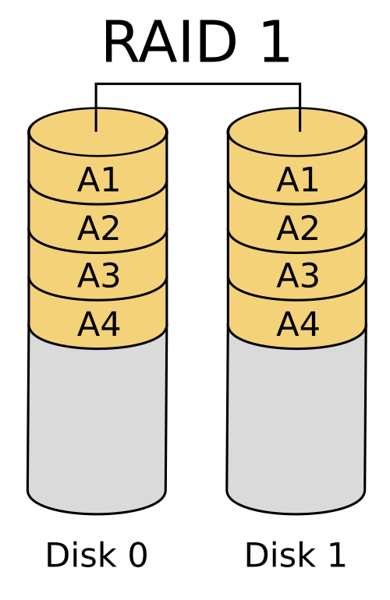
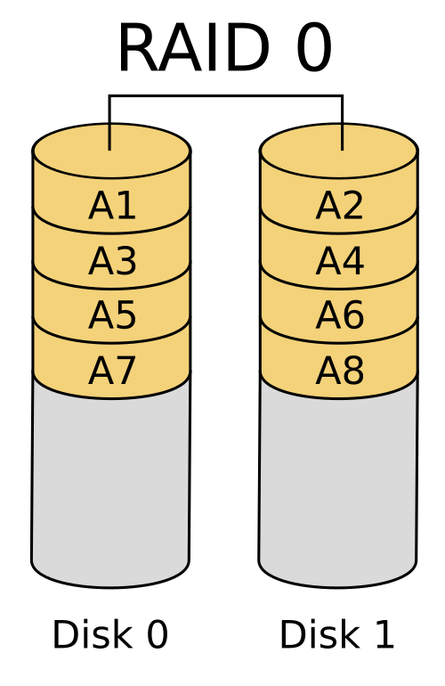
Disk mirroring
Disk stripping

Slide 35
RAID Levels
mirroring provides high reliability, but it is expensive
striping provides high data-transfer rates but does not improve reliability
alternative schemes aim to provide redundancy at lower cost by combining disk striping with “parity blocks”

Slide 36
for given set of blocks, parity block can be computed and stored on disk
the i^{th} bit of parity block is computed as “exclusive or” (XOR) of i^{th} bits of all blocks in set
if contents of any one of the blocks in a set is lost due to failure, block contents can be recovered by computing bitwise-XOR of remaining blocks in set, along with parity block
whenever a block is written, the parity block for its set must be recomputed and written to disk

Slide 37
RAID Levels

Slide 38
RAID level 0
refers to disk arrays with striping at the level of blocks, but without any redundancy (such as mirroring or parity bits)
array of size four disks

Slide 39
RAID level 1
refers to disk mirroring with block striping
mirrored organization that holds four disks’ worth of data

Slide 40
term RAID level 1+0 or RAID level 10 refer to mirroring with striping

Slide 41
RAID level 5
refers to block-interleaved distributed parity
data and parity are partitioned among all N + 1 disks; for each set of N logical blocks, one of the disks stores the parity, and the other N disks store the blocks; parity blocks are stored on different disks for different sets of N blocks
all disks can participate in satisfying read requests

Slide 42
the P’s are distributed across all disks
for example, with an array of five disks, parity block, labeled Pk, for logical blocks 4k, 4k + 1, 4k + 2, 4k + 3 is stored in disk k mod 5;
corresponding blocks of other four disks store four data blocks 4k to 4k + 3
parity block cannot store parity for blocks in the same disk, since then a disk failure would result in loss of data as well as of parity, and hence would not be recoverable

Slide 43
first 20 blocks, numbered 0 to 19, and their parity blocks are laid out; pattern gets repeated on further blocks

Slide 44
RAID level 6
the P + Q redundancy scheme, is much like RAID level 5, but it stores extra redundant information to guard against multiple disk failures
instead of using parity, level 6 uses error-correcting codes
two bits of redundant data are stored for every four bits of data -unlike one parity bit in level 5 - and system can tolerate two disk failures

Slide 45
P and Q denote blocks containing the two corresponding error-correcting blocks for a given set of data blocks
layout of blocks is an extension of that for RAID 5
with six disks, two parity blocks, labeled Pk and Qk, for logical blocks 4k, 4k + 1, 4k + 2, and 4k + 3 are stored in disk k mod 6 and (k + 1) mod 6, and corresponding blocks of other four disks store the four data blocks 4k to 4k + 3

Slide 46
Hardware RAID
Hardware RAID uses a dedicated controller for better performance and reliability (with features like battery-backed cache), ideal for critical systems, but costs more and ties data to specific hardware
Hardware RAID implementations can use non-volatile RAM to record writes before they are performed
Software RAID uses operating systems and CPU, making it flexible and cheap, great for non-critical tasks, but can slow the system and is less portable across different OS

Slide 47
server hardware is often designed to permit hot swapping
faulty disks can be removed and replaced by new ones without turning power off
RAID controller can detect that disk was replaced by new one and can immediately proceed to reconstruct data that was on old disk, and write it to new disk
Hot swapping reduces the mean time to repair
many critical systems today run on a 24 x 7 schedule; that is, they run 24 hours a day, 7 days a week, continuous, round-the-clock availability or operation, with no breaks providing no time for shutting down and replacing failed disk

Slide 48
power supply, or disk controller, or system interconnection in RAID system could become a single point of failure that could stop functioning of RAID
multiple redundant power supplies (with battery backups)
multiple disk interfaces
multiple interconnections to connect RAID system to computer system

Slide 49
Data Storage Structures

Slide 50
Disk-Block Access
requests for disk I/O are generated by database system, with the query processing subsystem responsible for most of disk I/O
data are transferred between disk and main memory in units of blocks

Slide 51
techniques for improving speed of access to blocks
Buffering
Read-ahead
Scheduling
File organization
Non-volatile write buffer

Slide 52
Buffering
blocks that are read from disk are stored temporarily in an in-memory buffer, to satisfy future requests
buffering is done by both operating system and database system

Slide 53
Read-ahead
when disk block is accessed, consecutive blocks from same track are read into an in-memory buffer even if there is no pending request
in case of sequential access ensures that many blocks are already in memory when they are requested, and it minimizes the time wasted in disk seeks
not very useful for random block accesses

Slide 54
Scheduling
if several blocks from disk need to be transferred we may be able to save access time by requesting blocks in order in which they will pass
commonly used algorithm is the elevator algorithm

Slide 55
File organization
organize blocks on disk in a way that corresponds closely to the way we expect data to be accessed
allocating consecutive blocks of a file to disk blocks that are consecutively numbered, ensure that files are stored sequentially

Slide 56
allocate consecutive blocks (an extent) at a time to a file
over time, sequential file that has multiple small appends may become fragmented;
to reduce fragmentation, system can make backup copy of data on disk and restore entire disk - the restore operation writes back the blocks of each file contiguously (or nearly so)
performance increases realized from these techniques can be quite significant

Slide 57
Non-volatile write buffer
can use non-volatile random-access memory (NVRAM) to speed up disk writes

Slide 58
Data Storage Structures
persistent data are stored on non-volatile storage, which, are block structured devices, that is, data are read or written in units of a block / page
databases deal with records, which are usually much smaller than a block
records are stored in files, taking block structure into account

Slide 59
File Organization
database is mapped into several different files that are maintained by operating system
file is organized logically as a sequence of records, records are mapped onto disk blocks
most databases use block sizes of 4 to 8 kilobytes by default, but many databases allow block size to be specified when database instance is created
assume that no record is larger than a block: realistic for most data-processing applications

Slide 60
in relational database, tuples of distinct relations are generally of different sizes
alternative is to structure our files so that we can accommodate multiple lengths for records
files of fixed-length records are easier to implement than are files of variable-length records

Slide 61
type employee = record
ID varchar (5);
name varchar(20);
dept_name varchar (20);
salary numeric (8,2);
end
employee record is 53 bytes long
simple approach is to use the first 53 bytes for the first record, the next 53 bytes for the second record, and so on, …

Slide 62
problems with this simple approach
unless the block size happens to be multiple of 53 (which is unlikely), some records will cross block boundaries
part of the record will be stored in one block and part in another - it would thus require two block accesses to read or write such a record
difficult to delete a record from this structure
space occupied by record to be deleted must be filled with some other record of the file, or we must have a way of marking deleted records so that they can be ignored

Slide 63
to avoid the first problem, we allocate only as many records to block as would fit entirely in block (number computed by dividing block size by record size) - any remaining bytes of each block are left unused
at beginning of file, we allocate a certain number of bytes as file header
header will contain information about file including the address of first record whose contents are deleted; then we use this record to store the address of second deleted record – available - and so on
deleted records thus form a linked list

Slide 64
Storing Large Objects
many databases internally restrict size of record to be no larger than size of a block
many databases allow records to logically contain large objects, but they store the large objects separate from the other attributes of records in which they occur; a (logical) pointer to object is then stored in the record containing the large object
large objects may be stored either as files in file system area managed by database, or as file structures stored in and managed by database

Slide 65
performance issues with storing large objects in databases
efficiency of accessing large objects via database interfaces
size of database backups.
enterprises periodically create “database dumps” that is, backup copies of their databases; storing large objects in database can result in large increase in the size of the database dumps
many database applications therefore choose to store very large objects outside of the database, in file system - in such cases, application may store file name (usually path in file system) as an attribute of a record in the database

Slide 66
storing data in files outside the database can result in file names in database pointing to files that do not exist, perhaps because they have been deleted, which results in a form of foreign-key constraint violation
further, database authorization controls are not applicable to data stored in the file system

Slide 67
Organization of Records in Files
Heap file organization
Sequential file organization
Multitable clustering file organization
B + -tree file organization
Hashing file organization

Slide 68
Heap file organization
any record can be placed anywhere in file where there is space for record; there is no ordering of records
typically, there is either a single file or a set of files for each relation
in a heap file organization, record may be stored anywhere in file corresponding to relation; once placed in particular location, record is not usually moved

Slide 69
Sequential file organization
records are stored in sequential order, according to the value of a “search key” of each record
designed for efficient processing of records in sorted order based on some search key - any set of attributes
to permit fast retrieval of records in search-key order, we chain together records by pointers
store records physically in search-key order, or as close to search-key order as possible

Slide 70
Multitable clustering file organization
records of several different relations are stored in the same file, and in fact in same block within a file, to reduce the cost of certain join operations

Slide 71
B + -tree file organization
related to B+ tree index structure can provide efficient ordered access to records even if there are a large number of insert, delete, or update operations - supports very efficient access to specific records, based on the search key

Slide 72
Hashing file organization
a hash function is computed on some attribute of each record - result of the hash function specifies in which block of the file the record should be placed
closely related to indexing structures

Slide 73
Partitioning
many databases allow records in relation to be partitioned into smaller relations that are stored separately; such table partitioning is typically done on the basis of an attribute value
for example, records in a transaction relation in an accounting database may be partitioned by year into smaller relations corresponding to each year, such as transaction_2018, transaction_2019, and so on, …
queries can be written based on transaction relation but are translated into queries on the year-wise relations

Slide 74
Data files contain data and objects such as tables, indexes, stored procedures, and views

Slide 75
Log files contain the information that is required to recover all transactions in the database

Slide 76
relational databases traditionally store all attributes of a tuple together in a record, and tuples are stored in a file as we have just seen
such a storage layout is referred to as a row-oriented storage

